Slide 1
Compressive Perceptual Hashing Tracking with Online Foreground Learning
Zheng Li, JianFei Yang, Juan Zha, Yiru Pan
Sun Yat-sen University
Notes:
Good afternoon, ladies and gentlemen, My name is Li Zheng, an undergraduate student from Sun Yat-sen University. Today, I am honored to be here to give you a presentation about “Compressive Perceptual Hashing Tracking with Online Foreground Learning”

Slide 2
Outline
Motivation
Feature extraction
Perceptual feature
Compressive sensing
Locality-sensitive hashing (LSH)
Tracking framework
Confidence
Coarse-to-fine search
Online Learning
Online foreground learning
Experiment results
Notes:
Out presentation mainly consists of 5 sections. The motivation, feature extraction, tracking framework, online learning and experiments results

Slide 3
Motivation
We introduce :
A simple and fast novel hashing methods of discriminative object representation for visual tracking
no need to train classifier.
perceptual feature + LSH + compressive sensing
A novel online foreground learning methods for solving model draft problems
dynamic weighted multi-scale patch model
Notes:
It’s quite common these days that visual tracking has become one of the most key components for numerous robot applications, such as robot human interaction, robot navigation and autonomous driving. Here, we introduce a simple and fast novel hashing methods for visual tracking. We adopt the combination of perceptual feature + LSH and compressive sensing methods as the discrimination object representation. Most importantly, the purpose of using hashing is no need to train classifier, which contributes to faster speed. Besides, we use a novel online foreground learning methods in order to solve model draft problem

Slide 4
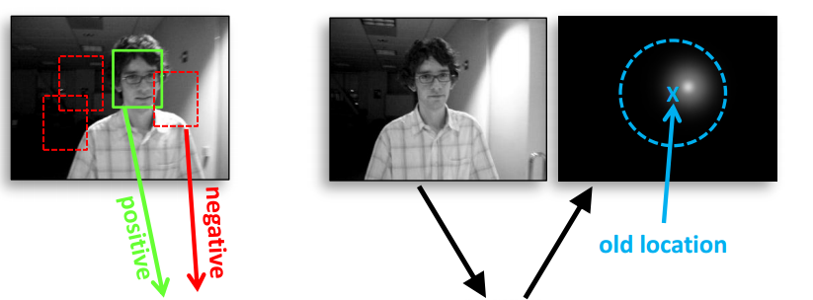
Algorithm Procedure
Tracking by detection
candidates
Compressive perceptual hashing matrix
Confidence evaluation
Notes:
The figure shows our algorithm procedure briefly. Generative and discriminative trackers are two main types of appearance-based trackers. Our method belongs to the latter, that is to say tracking be detection. At the t frame, we will obtain positive and negative samples around tracking object and extract our compressive perceptual hashing features. In the next frame, we will generate a series of candidates by coarse-to-fine search strategy. And then we will conduct confidence evaluation, and regard the candidate location of maximum confidence response as new position of object

Slide 5
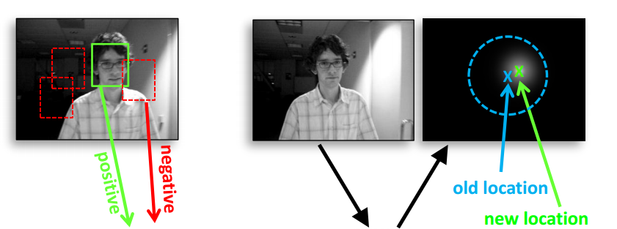
Algorithm Procedure
Tracking by detection
candidates
Compressive perceptual hashing matrix
Confidence evaluation

Slide 6
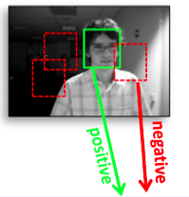
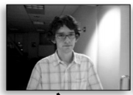
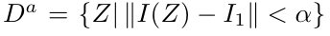
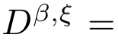
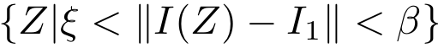
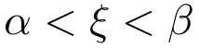
Samples
Positive samples:
Negative samples:
Sample radius:
Notes:
The Samples strategy is that we will obtain positive samples that are as close to real object as possible, within the radius of a, while negative samples are far from real object between the inner radius beta and outer radius elpson. In this way, we can ensure the quality of PN samples.

Slide 7
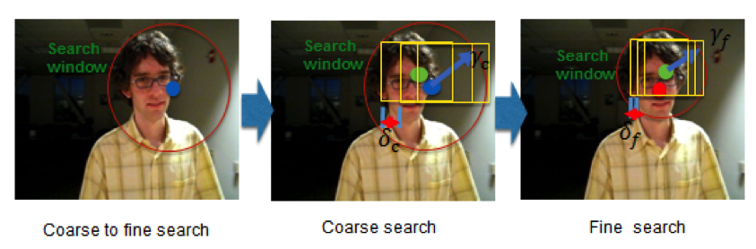
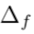
Coarse-to-fine search
Coarse search:
：: coarse radius
: coarse step
Fine search:
: fine radius
: fine step
Notes:
In terms of search strategy, we adopt a fast coarse-to-fine search, the speed of which is 4 times faster than the traditional method without sacrifice of accuracy After experiments, . Firstly, we will coarse search the maximum confidence response candidates in a larger step and radius. After ensuring the location of maximum confidence, we will repeat this process again by fine-search in a smaller step and smaller radius based on it. In this way, we can avoid searching all the candidates within a large radius.

Slide 8
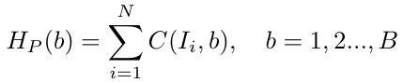
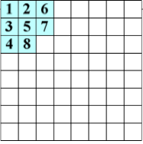
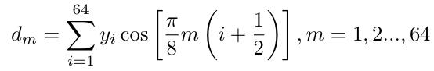
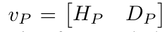
Perceptual feature
Standardization：an image patch resizes to 8 × 8
Feature extraction:
Grey histogram
B = 8
(Discrete cosine transform) DCT
Combination: a 16-d feature vector
Normalization
- Simple but robust combining with patch model
- Properties: scale, illumination, color invariant and so forth
DCT coefficients
Notes:
For our knowledge, We are the first to introduce a perceptual feature for visual tracking. Firstly, standardization, resize an image patch to 8 x 8 for the convenience of next processes. And then we will extract two simple types of feature, the grey histogram and DCT. The bins of grey histogram is 8 and for DCT matrix, we only use the 8 coefficients in the left upper corner in order to get the low frequency information. The combination of both generate our 16-dimension feature vector for the representation of an patch. Then, normalization. It’s quite simple but robust combining with patch model. And it include scale, illumination, color invariant and so forth properties

Slide 9
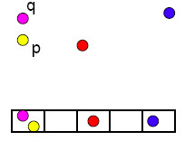
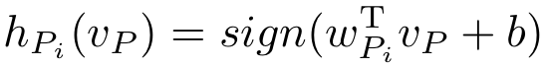
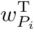
Locality-sensitive hashing
Hashing function：
is generated randomly between [-1,1]
under Gaussian distribution
- Share same for all patches
Feature space to hashing space
Generate a unique 16-d binary code for a patch
No need to train classifier, time-saving
Notes:
Then how to transform 16-dimension feature vector into binary code, that is to say the hashing method. Here, we adopt the locality-sensitive hashing (LSH), which is widely used in similarity search. And we just need a weight matrix, which is generated randomly between [-1,1] under Gaussian distribution. Most importantly, we share the same W matrix for all patches. It’s very time-saving. Thus, we generate a unique 16-dimension binary code for a patch. And the advantage about this is that it’s no need to train classifier, which contributes to our fast speed for tracking.

Slide 10
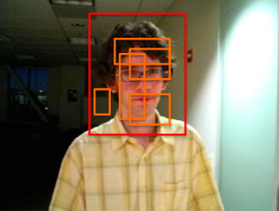
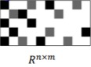
Multi-scale patch model
Compressive sensing
LSH
Perceptual feature
Feature pool
Feature selection
Discriminative
Representation
All of the scales and the positions should be considered
High complexity
- For computational efficiency, approximate method is necessary
Notes:
Here is our multi-scale patch model, we will obtain patches with different scale and location. All of the scales and the positions should be considered
Which contributes to high complexity. For the purpose of real-time tracking. It’s necessary to do feature selection, here we adopt compressive sensing method.
Which can reduce the high-dimensional signal to lower-dimensional space without losing the significant information at the same time. Finally,we get our disciminative representation

Slide 11
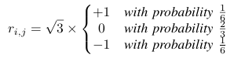
Compressive sensing
Random Sparse Matrix:
Satisfy Restricted isometry property (RIP)
K. Zhang, L. Zhang, and M.-H. Yang, “Real-time compressive tracking,”
in ECCV 2012. Springer, 2012, pp. 864–877.
Notes:
We refer to the real-time compressive tracking method. The compressive sensing theory [27] affirms that it is possible to reconstruct the signal from a small number of random measurements if a signal is K-sparse. The sparse measurement matrix R that satisfy restricted isometry property preserves the salient information in any K-sparse signal when projection.

Slide 12
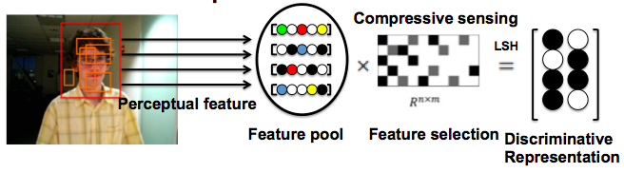
Dynamic weight multi-scale patch model
- Focus on information of actual object (foreground) in the tracking box
- Using Gaussian mixture model (GMM) to extract foreground of tracking box
- Take patch weight into consideration to make confidence evaluation
more robust
Notes:
However, when tracking the real object, model draft problem can occur. Thus in order to solve this problem, we take the foreground weight of each patch into consideration. We are required to focus on the information of actual object, that is to say the foreground in the tracking box. We can see it from the green line region. Here, we use GMM to extract foreground. And in this way we can assign each patch with corresponding weight during confidence evaluation to make it more robust.

Slide 13
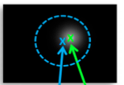
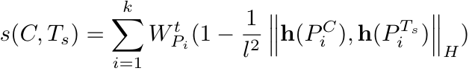
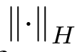

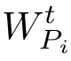
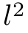
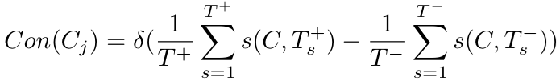
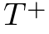
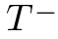
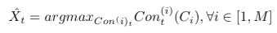
Confidence
Similarity between samples and candidates:
: hamming distance
: foreground weight of patch i at t-th frame
: total pixel of a patch
Confidence map
Confidence of candidates:
: the number of positive samples
: the number of negative samples
New location:
Notes:
Given a positive or negative samples and a candidates, we can calculate their similarity by this formula, actually, which is the transformation of hamming distance. When transferring, we will consider each patch weight. Thus, patch in foreground region has larger weight and we can more focus on the importance of it. Then, we can conduct confidence evaluation of each candidates, this formula means that, the maximum confidence candidate should be more similar to the positive samples and more dissimilar to the negative samples. At last,the new location can be ensured by MAP estimate function.

Slide 14
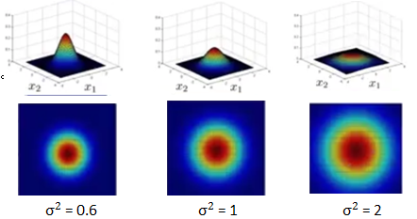
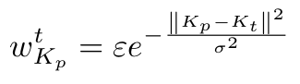
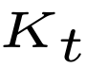
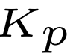
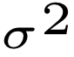
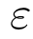
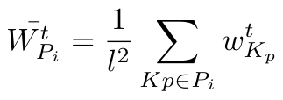
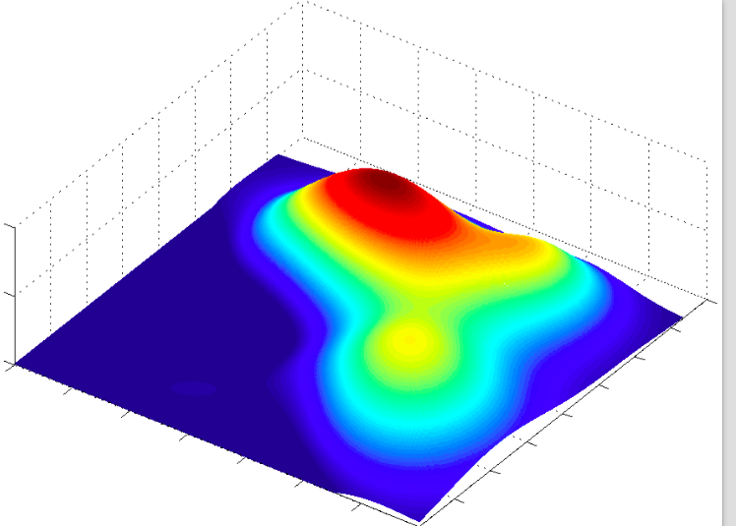
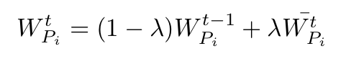
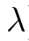
Online foreground learning
Current pixel weight
: weight center
: pixel center of a patch
: receptive field control factor
: normalization factor
Current patch weight
Receptive field control factor
Update patch weight
: learning rate
Dynamic foreground weight map
Notes:
But how to calculate our patch foreground weight? Firstly, we define a current pixel weight formula, which is a radial basis function(RBF), satisfying Gaussian distribution. kt and kp are weight center and pixel center of patch. At the beginning of the tracking procedure, all the pixel weight is same, one within the tracking region, Thus at the beginning the weight center is the center of the tracking box. Here, we regard the weight center as our visual attention center, the closer to our visual attention center, the more importance should be assgin. Thus, we define the Euler distance between the patch and weight center. And another importance thing is the sigma, a factor which controls the receptive field. We can understand it clearly from the right figure, the bigger sigma is, the larger receptive field we can pay attention to. After getting each pixel weight, we can calculate the average patch weight. And last, by taking the both of previous weight and current weight into consideration, we learn the true importance of each patch. The right picture shows the dynamic foreground weight map during tracking.

Slide 15
Experiment Results
20 FPS in C++
Not need to specifically tune parameter
15 state-of-the-art compared trackers and 24 representative challenging sequences with different attributes from visual tracking benchmark.
Robust to various challenges
Background clutters
Fast motion & Motion blur
In-Plane & Out-of-Plane rotation
Occlusion
Scale & Pose variation
Severe illumination changes

Slide 16
Experiment Results

Slide 17
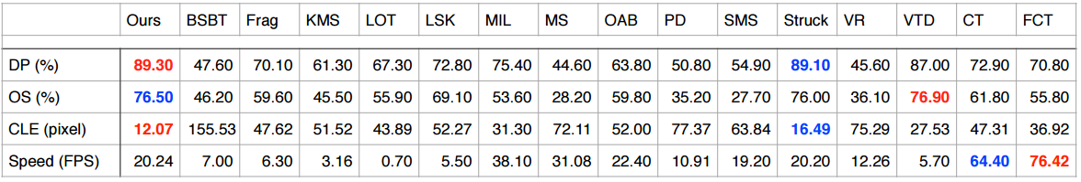
Quantitative Evaluation
Evaluation metrics:
DP: distance precision, the percentage of frames whose estimated location is within the given threshold distance of the ground truth
OS: overlap success rate, the percentage of frames where the bounding box overlap rate surpasses a threshold
CLE: center location error, the average Euclidean distance between the ground-truth and the estimated center location

Slide 18
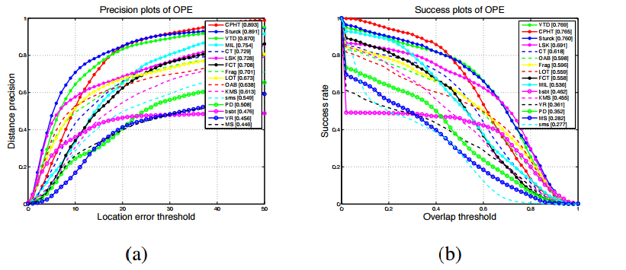
Quantitative Evaluation
Overall performance

Slide 19
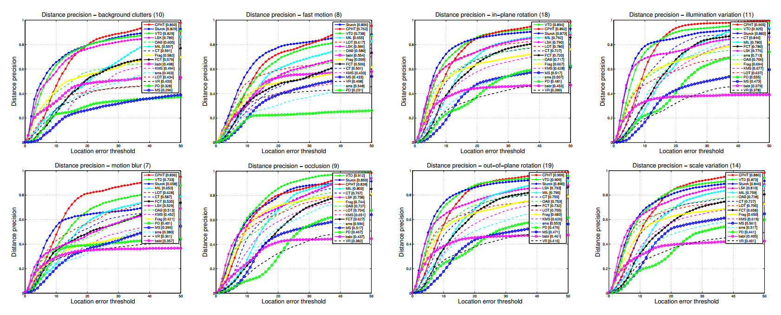
Attribute-base Evaluation

Slide 20
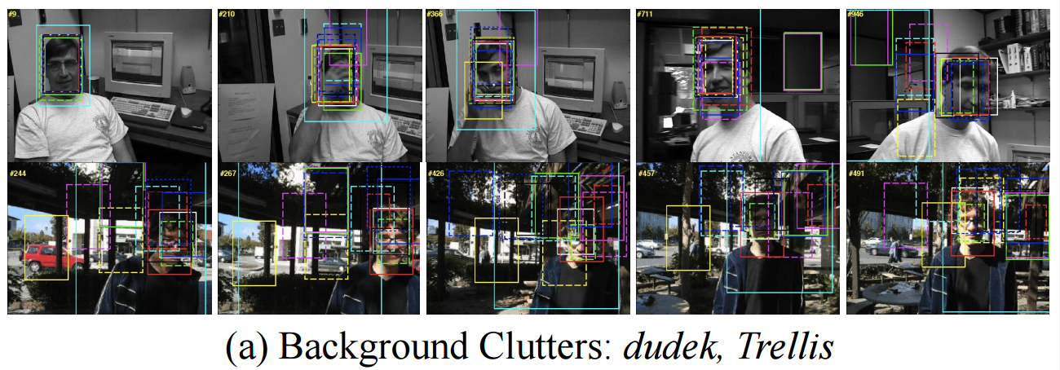
Qualitative Evaluation

Slide 21
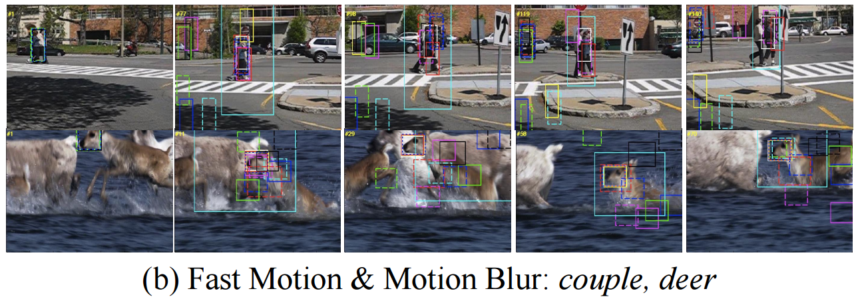
Qualitative Evaluation

Slide 22
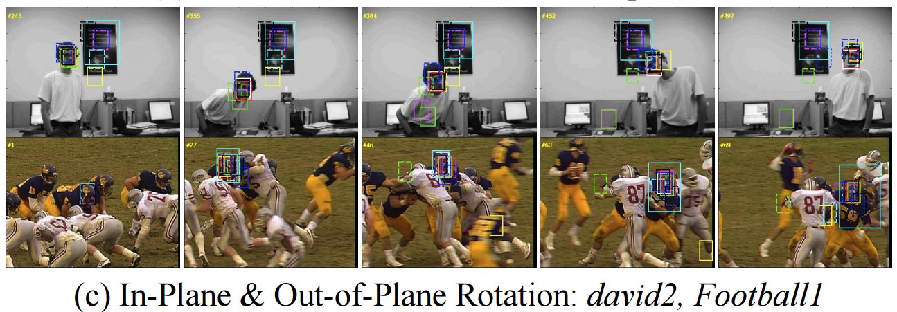
Qualitative Evaluation

Slide 23
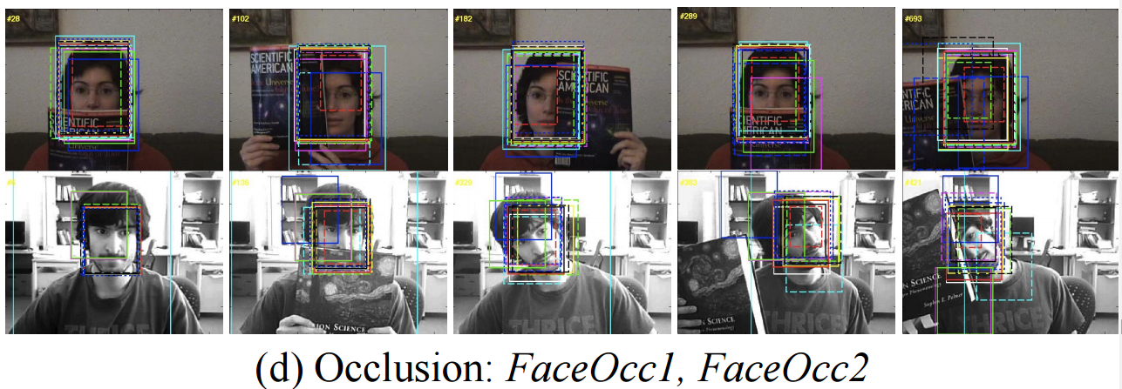
Qualitative Evaluation

Slide 24
Thanks for your Listening

